Slide 1
M.Sc. (Integrated) Five Years Program
AIML/Data Science
Semester-VII
Department of AIML & Data Science
School of Emerging Science and Technology
Gujarat University
Name | ZEEL RATHI
Roll No. | 26 | 26
Subject Code | CC – 406 | Subject Name | PROJECT – II :Project
Topic | YOGA POSE DETECTION AND CLASSIFICATION

Slide 2
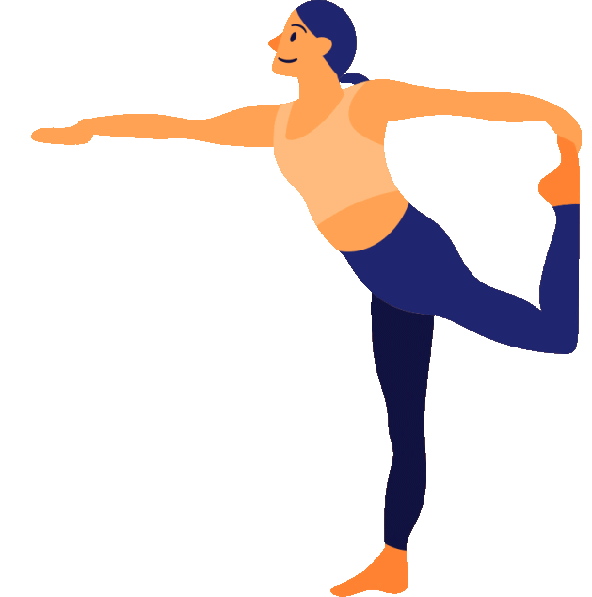

YOGA POSE DETECTION AND CLASSIFICATION
BY ZEEL RATHI
AIML- SEM 7

Slide 3


OUTLINE
1. INTRODUCTION
2. DEFINITION PROBLEM
3. OBJECTIVE
4. DATASETS DESCRIPTION
5. LITERATURE SURVEY
6. WORKFLOW
7. METHODOLOGY
8. RESULTS

Slide 4


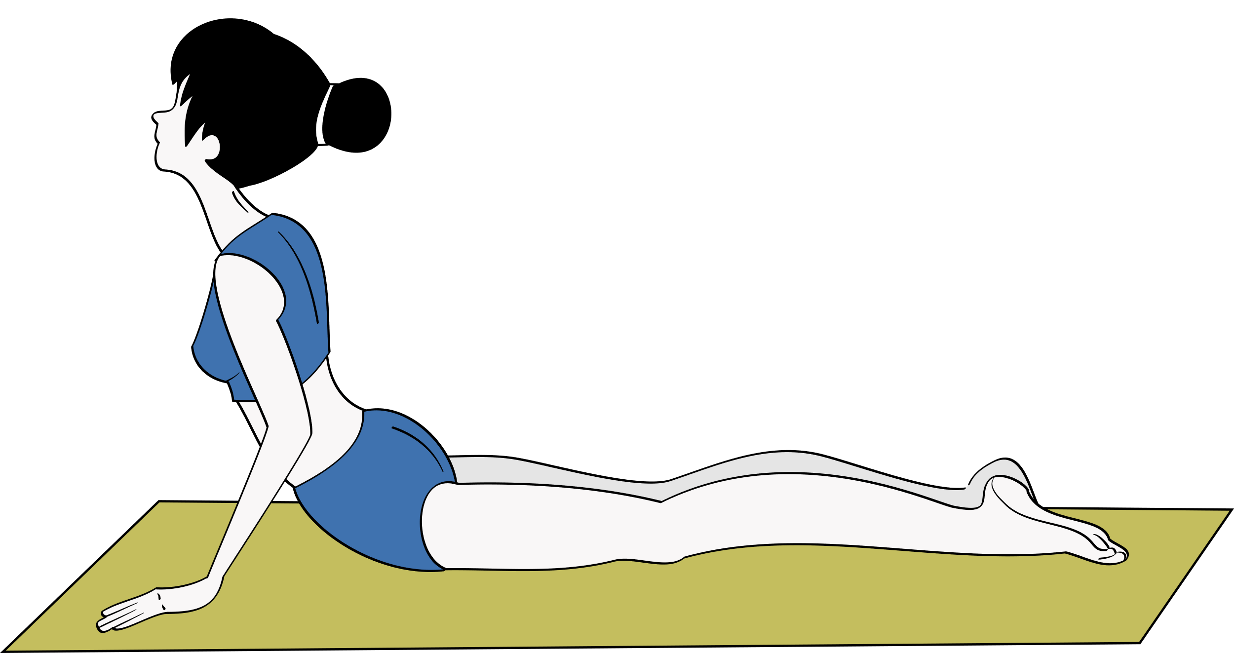
INTRODUCTION
It is important to practice
yoga poses accurately as any
abnormal posture tends to cause harm.
It is not always possible to have
an instructor or to join yoga classes
with nowadays lifestyle.
Person must follow the proper
guidelines to gain maximum benefit
from following a particular yoga routine.
An AI-based system
helps to identify yoga poses and
gives feedback or suggestions to users.
Increasing demand for the development
of computer-assisted training systems
from the practitioner side to help them to improve their knowledge

Slide 5




PROBLEM DEFINATION
Human pose detection is a computer vision technique used to predict the position/pose
or joint position of a part of the human body.
Pose detection allows us to analyze the static posture of humans, which will provide
valuable information regarding posture correctness.
identifIcation of several state-of-the-art methods for pose estimation that accurately estimate human poses under a variety of sensor configurations, shots, and counts of individuals per shot.
Human pose detection has benefited from deep learning, with significant
performance improvements. The machine learning approach provides an
easier way to map structures than to handle dependencies between structures.

Slide 6


OBJECTIVE
1] DETECTING ANGLES
After selecting the desired pose, abnormal angles between the actual pose and the user pose are detected.
2] ESTIMATING ERROR
The model compares the derived key points of user and per defined sets
3] GENERATING FEEDBACK
A message will appear that directs the user to make any change to correct the error

Slide 7
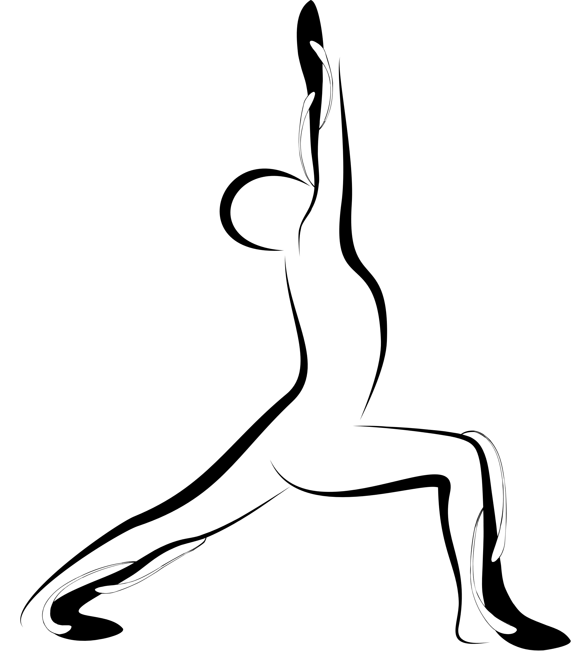


DATASETS DESCRIPTION
The datasets include yoga poses such as:
TREE POSE
Vrishkhasana
WARRIOR II POSE
Virbhadrasana - 2
T POSE
Trikonasana

Slide 8

The dataset used for this project
There are no of photos or videos of people doing yoga poses.
The rate at which the video was recorded is 30 FPS
These videos are recorded in a room by a camera from a distance of 4 m
To trains models robustly, individuals performed these poses with few variations.

Slide 9
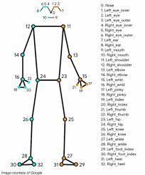
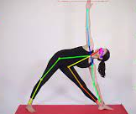

Slide 10
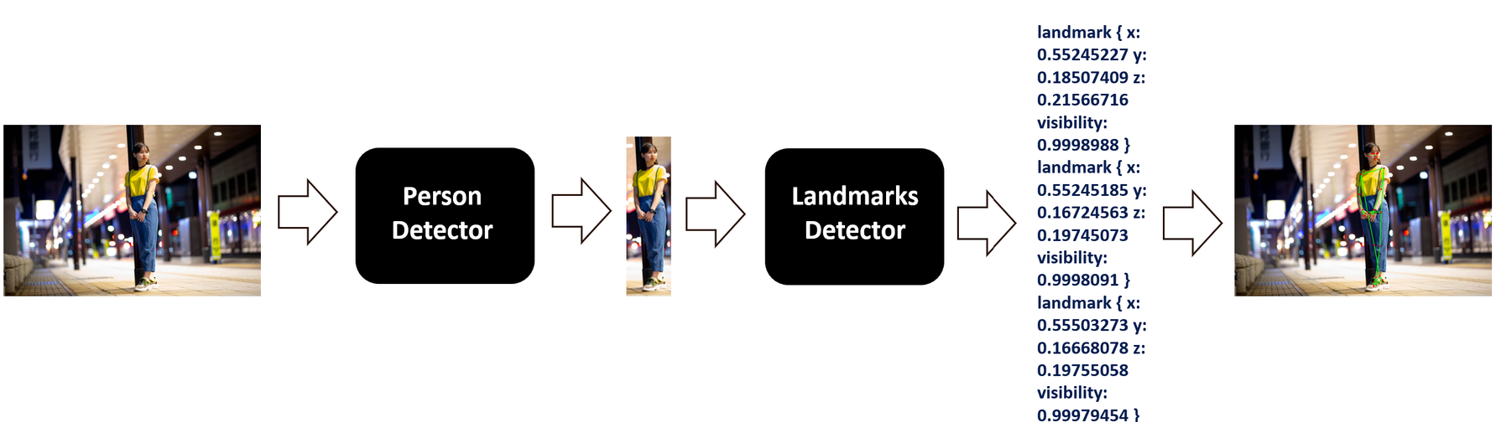
MAIN LIBRARY USED : MEDIAPIPE
MediaPipe provides a robust solution capable of predicting thirty-three 3D landmarks on a human body in real-time.
It utilizes a two-step machine learning pipeline, by using a detector it first localizes the person within the frame and then uses the pose landmarks detector to predict the landmarks within the region of interest.

Slide 11
LITERATURE SURVEY
In 2018 Chen HT et al proposed a system of tracking human pose using Kinetic console sensors in "Computer-assisted yoga training system"
--> Feature based approach was used.
In 2017 "Multi-Modal Posture Recognition System for Healthcare Applications" was made.
--> used a combination of 3D depth mapping techniques.
-->capture the posture parameters of the person in real-time and then to predict
their pose it is compared with existing data parameters of known poses.

Slide 12
--> In 2014 Alexander Toshev and Christian Szegedy presented the paper
"DeepPose: Human Pose Estimation via Deep Neural Networks"
able to fully capture the context of each body and their relation with adjacent joints.
methos is much faster and easier to formulate

Slide 13

WORKFLOW
Data Collection
Pose Extraction
Pose Identification
Error estimation

Slide 14
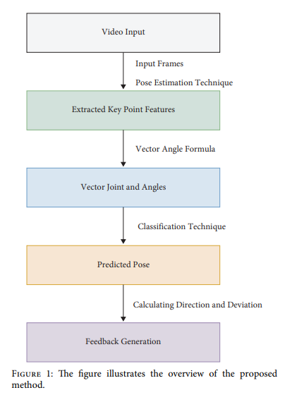

Slide 15

PROPOSED METHODOLOGY
STEP 1 : POSE EXTRACTION
processed by the model to extract main body points from the data.
each particular point is labelled with a index value
each point have its own x, y and z coordinates
providing the value of the joint.
STEP 2 : POSE IDENTIFICATION
identifying the pose of the user by using all points for recognition
x, y, z used to determine the structure of the body.
STEP 3: ERROR ESTIMATION AND FEEDBACK
if any inconsistency is detected, a message appears directs the user to do adjustments

Slide 16
This function classifies yoga poses depending upon the angles of various body joints.
ARGUMENTS USED
landmarks: A list of detected landmarks of the person whose pose needs to be classified.
output_image: A image of the person with the detected pose landmarks drawn.
display: A boolean value that is if set to true the function displays the resultant image with the pose label written on it and returns nothing.

Slide 17
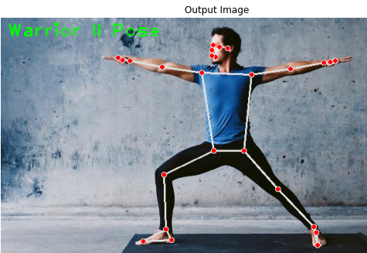
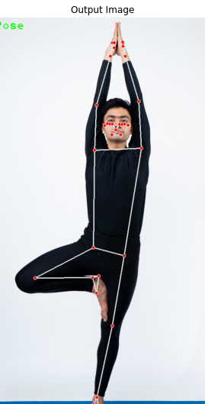
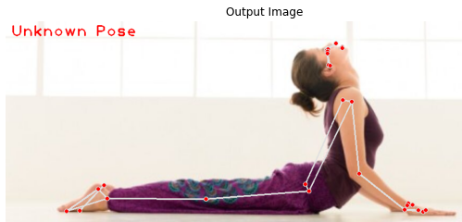
RESULTS
Output Image: The image with the detected pose landmarks drawn and pose label written.
Label: The classified pose label of the person in the output_image.

Slide 18
CONCLUSION
A developed system which consists of a pipeline for pose identification and then point localization on human body followed by a error identification process aims at helping people to perform yoga in a correct manner on their own and prevent injuries that can happen due to incorrect practices in yoga.

Slide 19
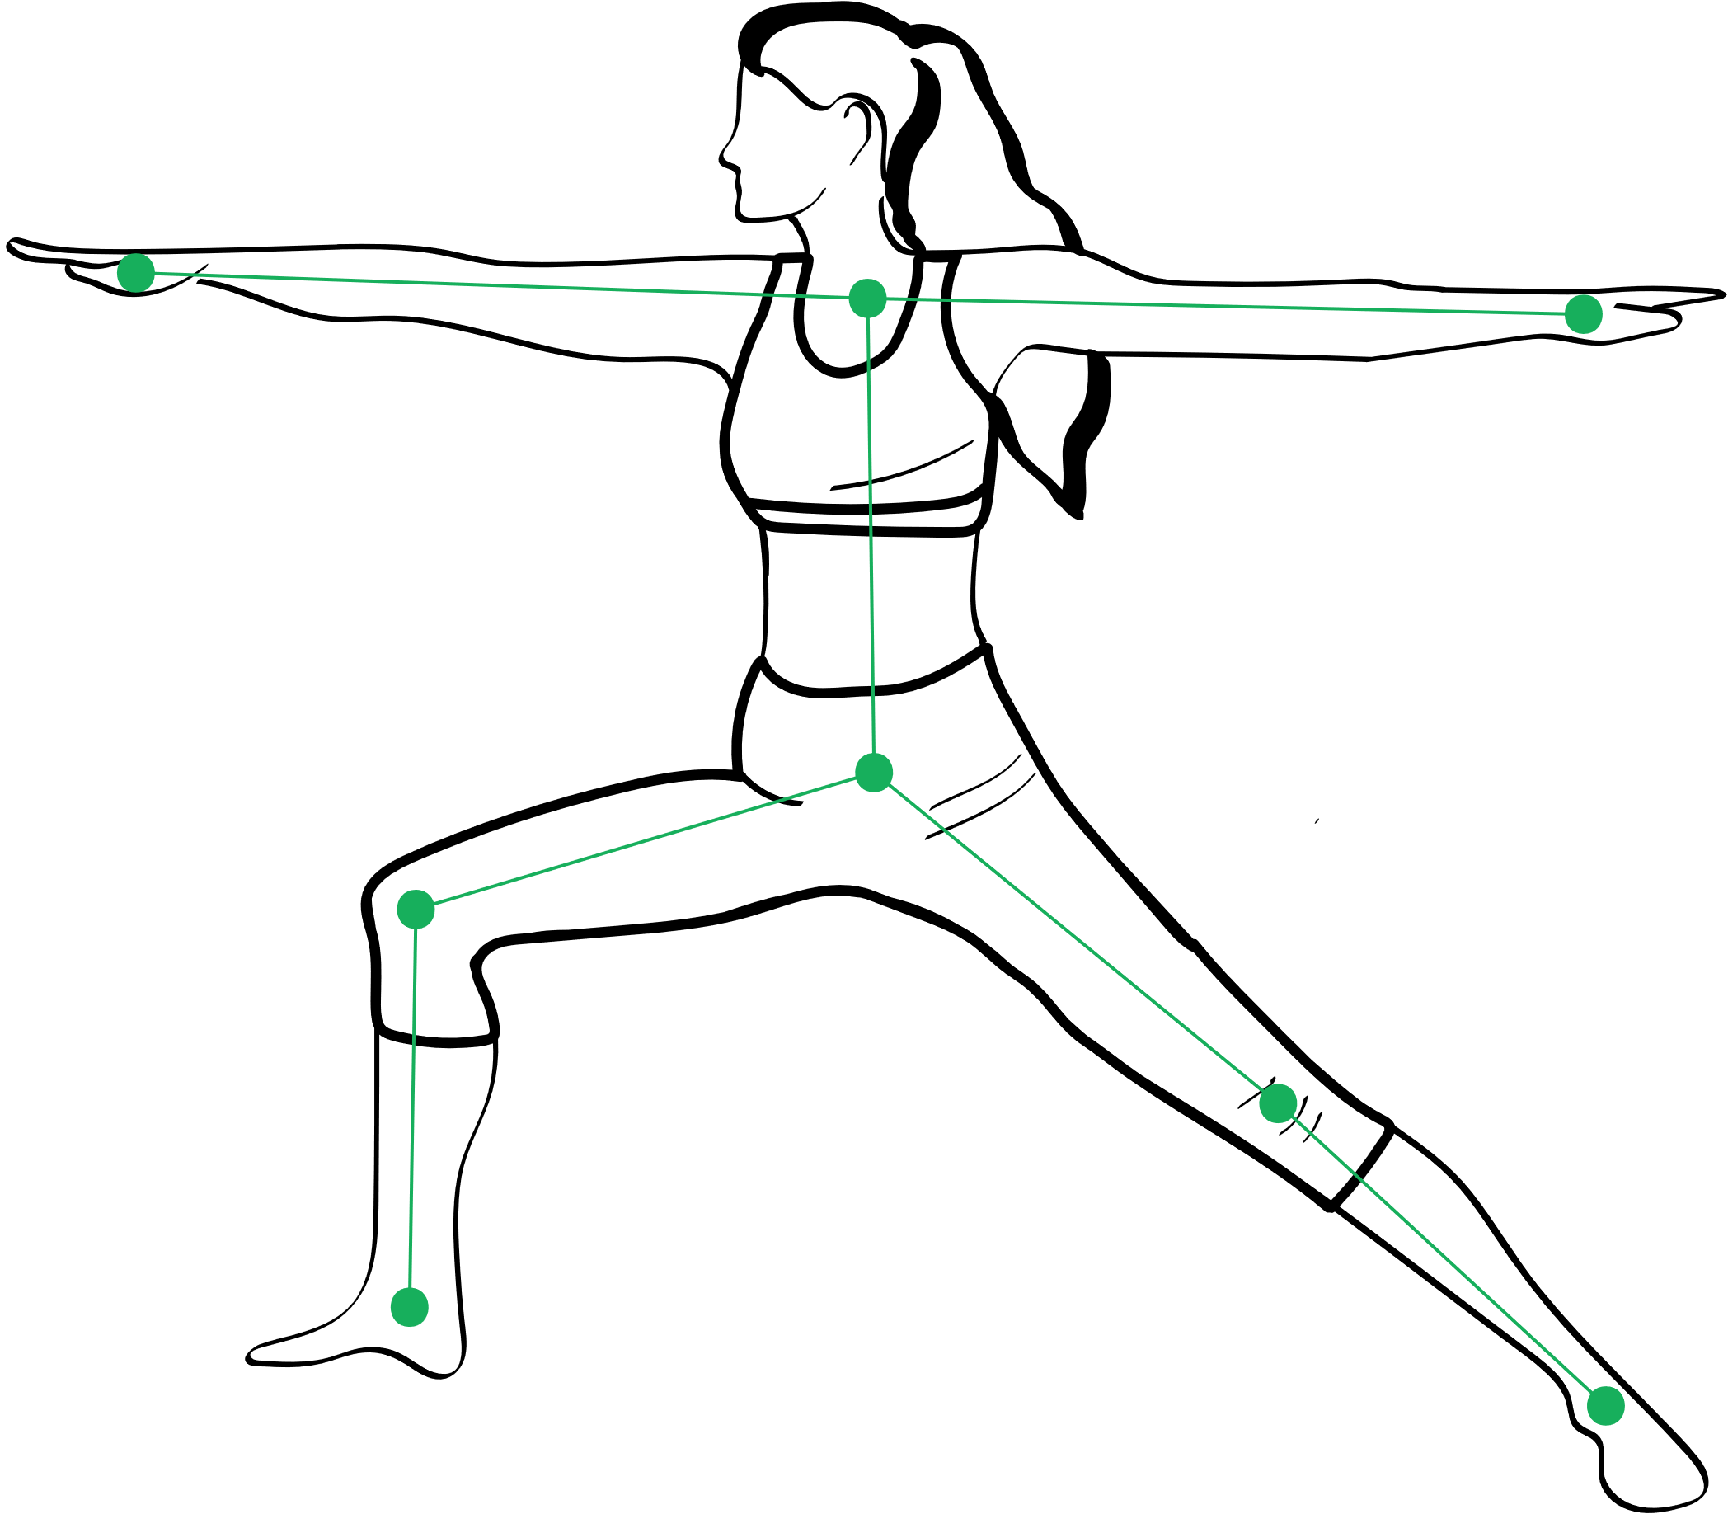
THANK YOU!

